Slide 1
Dockers & Kubernetes
Docker Swarm

Slide 2
Session Agenda
Need for Orchestration
Docker Swarm
How to create swarm cluster
Creating a service in swarm
Updating a service in swarm

Slide 3
Need for orchestration
Imagine that you have to run hundreds of containers. You can see that if they are running in a distributed mode, the following aspects are to be taken care of:
Health Checks on the Containers
Launching a fixed set of Containers for a particular Docker image
Scaling the number of Containers up and down depending on the load
Performing rolling update of software across containers
and many more
Orchestration tools take care of these for us and make the large scale deployment easy.

Slide 4
Docker swarm
Docker Swarm is a cluster-management-and-orchestration tool that makes it easy to scale and manage your Docker services.
A swarm consists of multiple Docker hosts that run in so-called swarm mode and act as
managers (managing member relationships)
or as workers (running the services)
A Docker host can be a manager, worker, or can perform both roles.
When creating a service in a swarm, we define the optimal state of our service and Docker will try to maintain this desired state

Slide 5
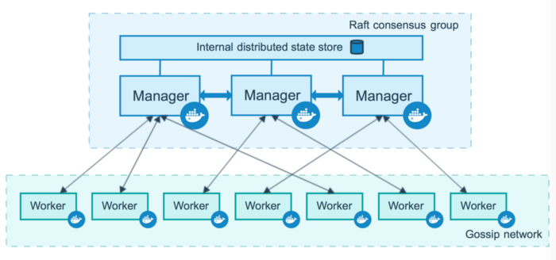
Node
A node is an instance of the Docker engine participating in the swarm. You can run one or multiple nodes on a single device

Slide 6
Manager Node
Manager nodes distribute and schedule incoming tasks onto the worker nodes, maintain the cluster state, and perform orchestration and cluster-management functions.
Cluster management tasks of a manager node include:
Maintaining the cluster state
Scheduling services
Serving swarm mode HTTP API endpoints
There should always be multiple manager nodes in your swarm because of the following reasons:
Maintaining high availability
Easily recover from a manager-node failure without downtime

Slide 7
Worker Node
Worker nodes are also instances of the Docker Engine whose sole purpose is to execute containers and services as instructed by the manager nodes.
To deploy your application to a swarm, you need at least one manager node. By default, all manager nodes are also workers.
To prevent the scheduler from placing tasks on your manager node in a multi node swarm, you need to set the availability to Drain
docker node update --availability drain <hostname>

Slide 8
Docker Swarm Setup
Initialize the swarm on manager node:
docker swarm init --advertise-addr MANAGER_IP
Output:
docker swarm init — advertise-addr 192.168.1.8
Swarm initialized: current node (5oof62fetd4gry7o09jd9e0kf) is now a manager.
To add a worker to this swarm, run the following command:
docker swarm join — token SWMTKN-1–5mgyf6ehuc5pfbmar00njd3oxv8nmjhteejaald3yzbef7osl1-ad7b1k8k3bl3aa3k3q13zivqd 192.168.1.8:2377
To add a manager to this swarm, run ‘docker swarm join-token manager’ and follow the instructions.

Slide 9
Docker Swarm Setup
Joining as Worker Node:
docker swarm join-token worker
output:
To add a worker to this swarm, run the following command:
docker swarm join — token SWMTKN-1–5mgyf6ehuc5pfbmar00njd3oxv8nmjhteejaald3yzbef7osl1-ad7b1k8k3bl3aa3k3q13zivqd 192.168.1.8:2377

Slide 10
Docker Swarm Setup
Joining as Manager Node:
docker swarm join-token manager
output:
To add a manager to this swarm, run the following command:
docker swarm join — token SWMTKN-1–5mgyf6ehuc5pfbmar00njd3oxv8nmjhteejaald3yzbef7osl1–8xo0cmd6bryjrsh6w7op4enos 192.168.1.8:2377

Slide 11
Swarm status
To get the status of the swarm we can run the below command:
docker node ls
output:
ID HOSTNAME STATUS AVAILABILITY MANAGER STATUS
1ndq**** worker2 Ready Active
1qh4**** worker1 Ready Active
25nw**** worker3 Ready Active
5ooe**** manager1 Ready Active Leader

Slide 12
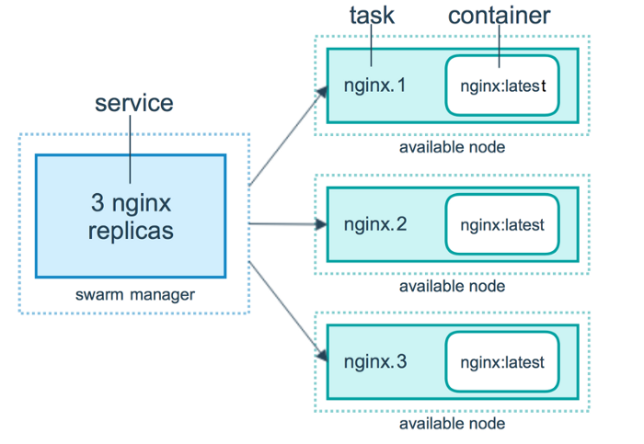
services
A service is the definition of the tasks to execute on the nodes.

Slide 13
Task scheduling
A task carries a Docker container and the command that’s executed inside of the container.
It is the atomic scheduling unit of the swarm.
Tasks are assigned by the manager node to worker nodes according to the number of replicas set in the service.
Each task is a slot the scheduler fills by spawning a container which is the instantiation of a task.
When one of these containers fails its health check or crashes, the orchestrator creates a new replica task that spawns a new container to replace the failing one.

Slide 14
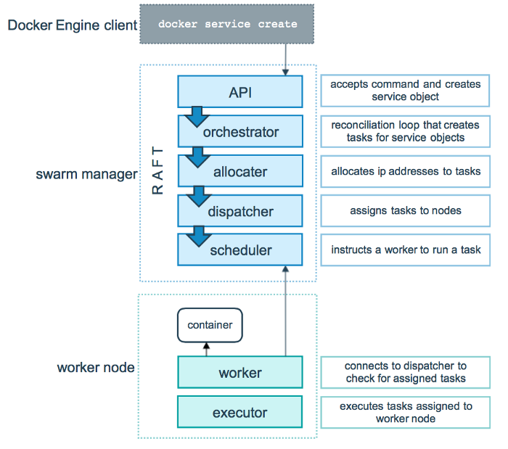
Task scheduling

Slide 15
Scaling up and down a Service
We can scale the number of containers running in a service by using the scale command:
docker service scale <SERVICE-ID>=<NUMBER-OF-TASKS>
You can get the details of your service using the inspect command:
docker service inspect SERVICE_NAME

Slide 16
Updating a Service
Docker Swarm also lets you perform a rolling update on your running services. Rolling updates have the following advantages:
No downtime (because it only updates a specific amount of replicas at a time)
Updates can be paused when an error occurs
Updates are performed using the docker service update command:
docker service update --image <imagename>:<version> <service-name>

Slide 17
Updating a Service
Update order:
Defines if the new container starts before the old one is killed or otherwise.
docker service update --update-order <start-first/stop-first> <service-name>
Parallelism:
This flag will tell Swarm how many tasks it’ll update in parallel.
docker service update --update-parallelism 3 <service-name>

Slide 18
Updating a Service
Defining a rollback
Docker Swarm allows you to automatically rollback to previous versions of your services.
docker service rollback <service-name>
They can also automatically be executed when an error occurs in the update process.
docker service update --detach=false --update-failure-action rollback <service-name>

Slide 19
Useful links
https://docs.docker.com/engine/swarm/
https://rominirani.com/docker-swarm-tutorial-b67470cf8872
Katakoda interactive course on docker swarm:
https://www.katacoda.com/courses/docker-orchestration/getting-started-with-swarm-mode

Slide 20
Thank you!

